Slide 1

Urban Livability Planning
The goal is to automatically detect and assess areas that have a high livability.
Based on various parameters, we can classify the area as livable or not livable.

Slide 2
What are we trying to do?
There are six major parameters to be considered for classification:
NDVI – for getting and visualizing the vegetation of an area.
NDWI – for getting and visualizing the water levels of an area.
UHI – for getting and visualizing the surface temperature of an area.
AQI – for getting and visualizing the air quality of an area.
Noise Proxy – for getting and visualizing the noise levels of an area.
NDBI – for getting and visualizing the built-up levels of an area.
These metrics are converted into individual scores, then combined into a final livability score.

Slide 3
Parameter-1 Natural Difference Vegetation Index(NDVI)
Measures vegetation health by comparing near-infrared and red light reflectance.
Satellite: Sentinel-2
Sensor: MSI (Multi Spectral Instrument)
Bands Used:
Band 8 (NIR): Near Infrared (842 nm)
Band 4 (Red): Red (665 nm)
Formula Used:
NDVI = (NIR-Red)/(NIR+Red)​

Slide 4
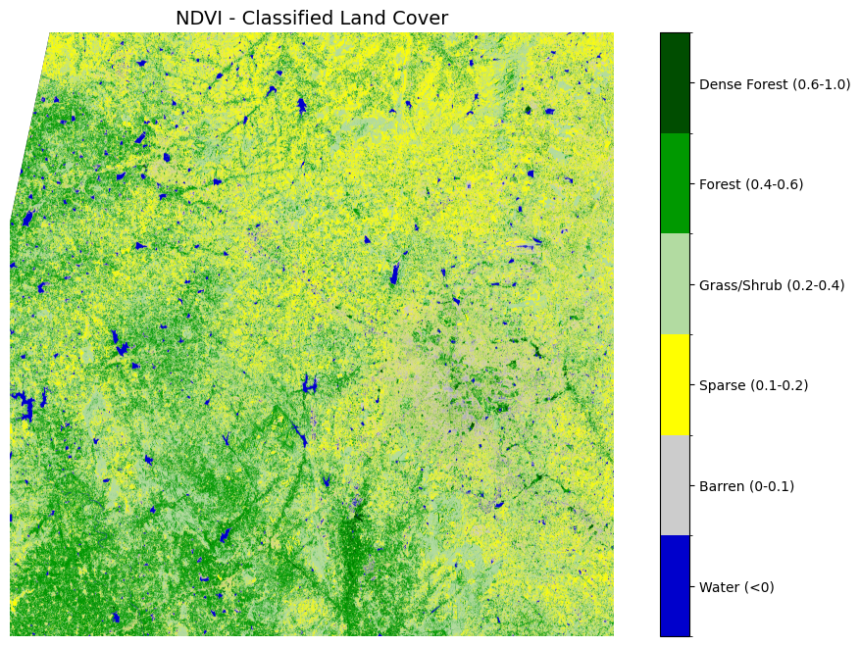
Example :-

Slide 5
Parameter-2 Natural Difference Water Index(NDWI)Index) Parameter 2 – SSIM (Structural Similarity Index)
Detects water bodies by comparing green and near-infrared reflectance.
Satellite: Sentinel-2
Sensor: MSI (Multi Spectral Instrument)
Bands Used:
Band 3 (NIR): Green (560 nm)
Band 8 (NIR): Near Infrared (842 nm)
Formula Used:
NDWI = (Green - NIR)/(Green + NIR)​

Slide 6
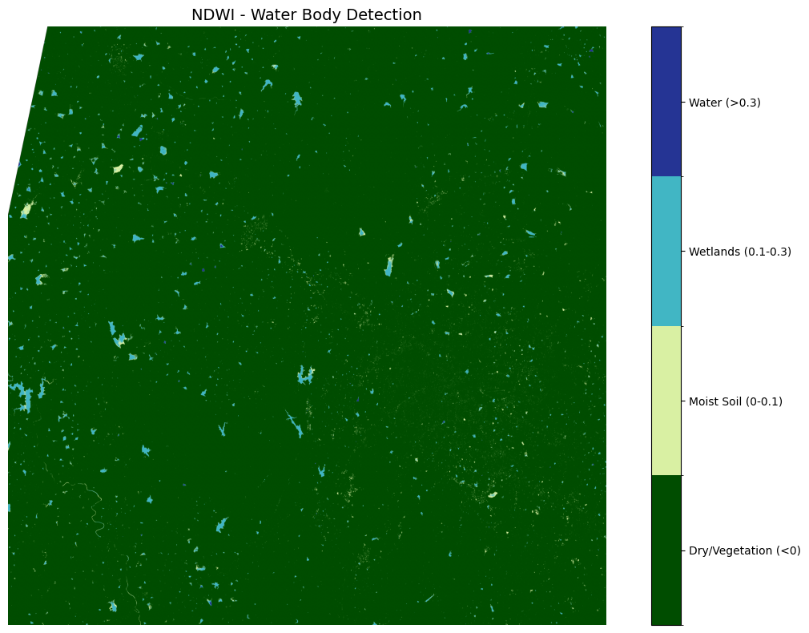
Example :-

Slide 7
Parameter 3 – Air Quality Index
Quantifies air pollution levels based on concentrations of pollutants like NO₂, CO and O₃.
Satellite: Sentinel 5P
Sensor: TROPOMI (Tropospheric Monitoring Instrument)
Bands Used:
Nitrogen dioxide Tropospheric column
Latitude
Longitude

Slide 8
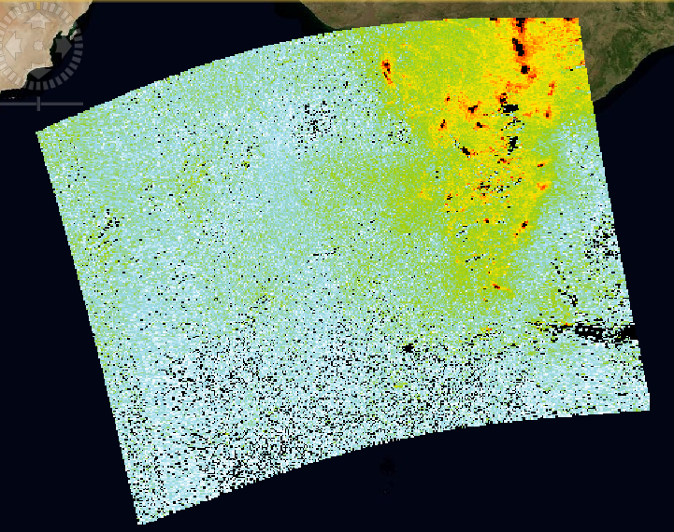
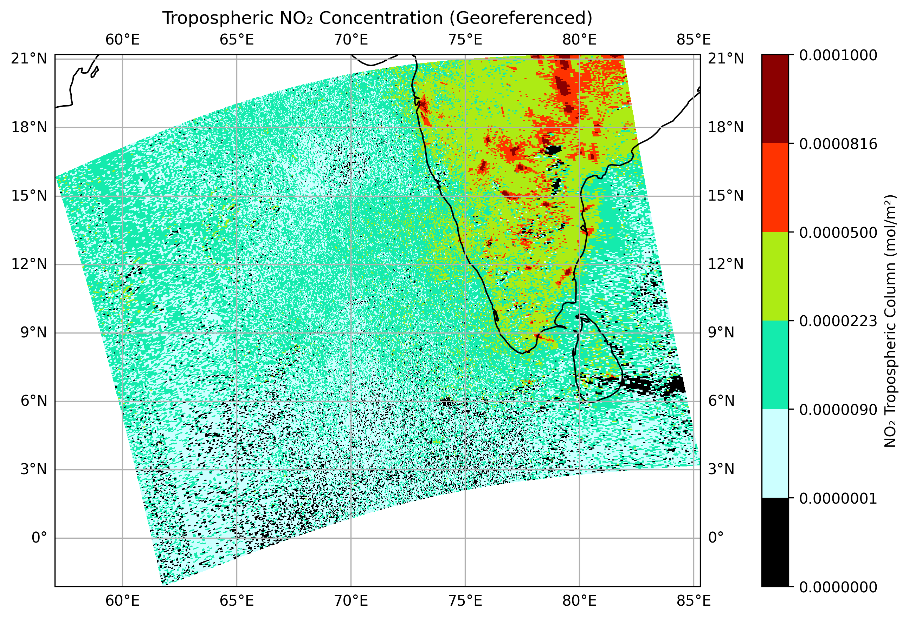
Example :-

Slide 9
Parameter 4 – Natural Difference Built-up Index (NDBI)
index used in remote sensing, specifically to identify built-up areas (urban areas) in satellite images, particularly in multispectral data.
Satellite: Sentinel 2
Sensor: MSI(Multi Spectral Index)
Bands Used:
Band 11 (SWIR): Green (1610 nm)
Band 8 (NIR): Near Infrared (842 nm)
Formula Used:
NDBI = (SWIR - NIR)/(SWIR + NIR)
Reference : Spectral Indices in Remote Sensing: Meaning and Applications (An example). | Spatial node

Slide 10
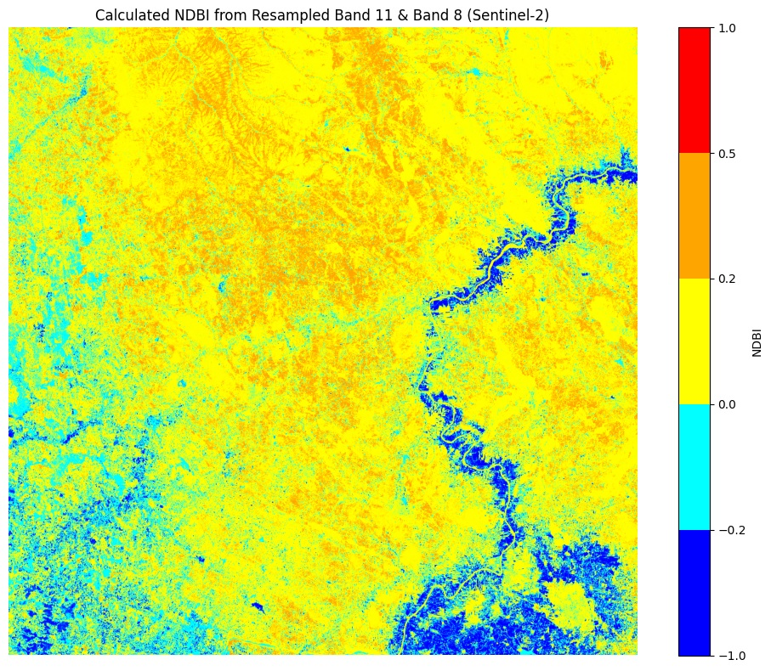
Example :-

Slide 11
Parameter 5 – Noise Proxy
Quantifies Noise pollution of area based on night light artifacts.
Satellite: VIIRS-DNB (from NASA EarthData)
Sensor: VIIRS Day/Night Band
Bands Used: Day-Night Band: Visible (500–600 nm)
Formulae Used:
N=β0​+β1​⋅L

Slide 12
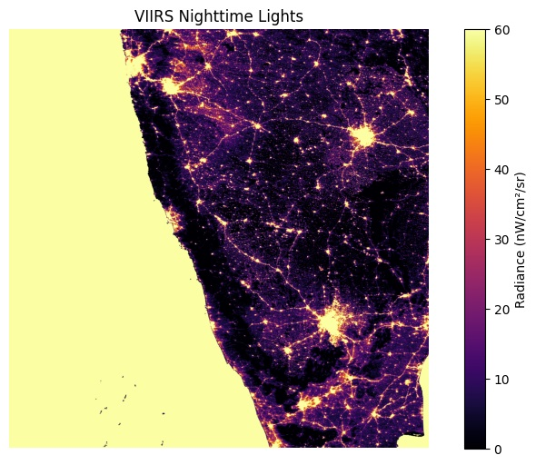
Example :-

Slide 13
Parameter 6 – Urban Heat Index
Represents the radiative temperature of the land derived from thermal infrared sensors.
Satellite: Landsat 8
Sensor: TIR (Thermal Infrared)
Bands Used: Band 10 : Thermal Infrared Sensor (10.85 µm)
Formulae Used:
Lλ​=Mλ​×Qcal​+Aλ​
Where:
Mλ​ = Band-specific multiplicative rescaling factor (from the metadata)
Aλ​ = Band-specific additive rescaling factor (from the metadata)
Qcal​ = Digital number (DN) from the thermal band

Slide 14
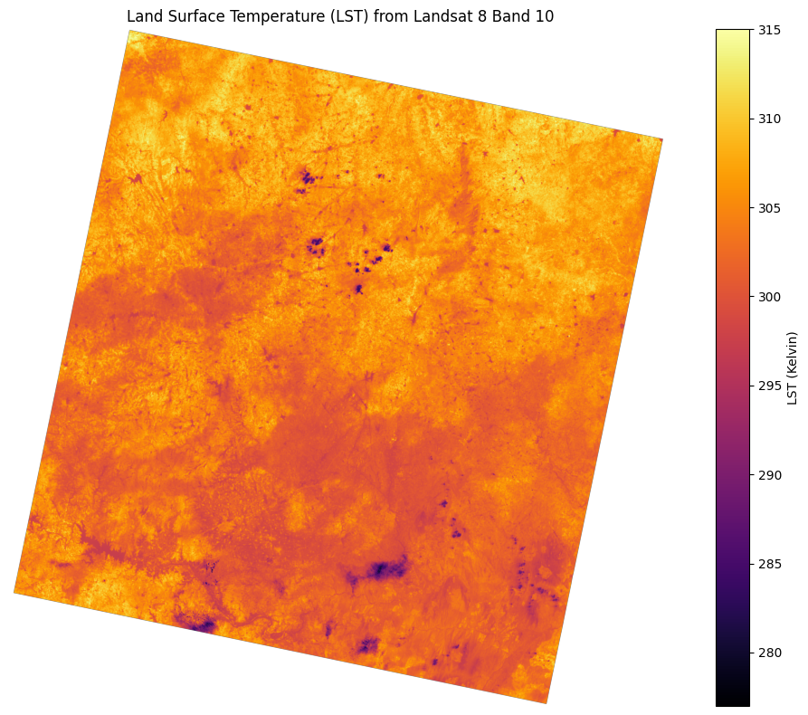
Example :-

